Slide 1


AIBridge
Lecture 3

Slide 2
Lecture Outline
What is a function?
Built-ins
Importing
Function defining

Slide 3
What is a function?
Function
Input
Output

Slide 4
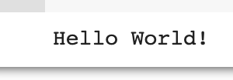
What is a function?
print()
Print
"Hello world!"

Slide 5
Lecture Outline
What is a function?
Built-ins
Importing
Function defining

Slide 6

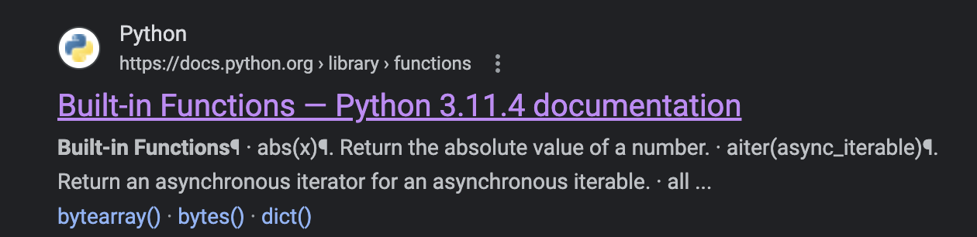
Built-ins
https://docs.python.org/3/library/functions.html
1
2
Notes:
Standard input and output formats vary with compiler.
Emphasize that you have to close file

Slide 7
Lecture Outline
What is a function?
Built-ins
Importing
Function defining

Slide 8


Importing
Burp
Python
Module
Notes:
Importing is particularly important because we don’t want to reinvent the wheel. Other people have already heavily optimized and published modules and functions and we can build up from that foundation. The general syntax for importing is…

Slide 9
Importing
import sklearn
from sklearn import linear_model
import sklearn as skl
Notes:
Importing is particularly important because we don’t want to reinvent the wheel. Other people have already heavily optimized and published modules and functions and we can build up from that foundation. The general syntax for importing is…

Slide 10
Lecture Outline
What is a function?
Built-ins
Importing
Function defining

Slide 11
Function defining
Arguments passed
def function_name(arg1, arg2, ...):
# do stuff here
Notes:
Importing is particularly important because we don’t want to reinvent the wheel. Other people have already heavily optimized and published modules and functions and we can build up from that foundation. The general syntax for importing is…

Slide 12
Function defining
Arguments passed
return
def function_name(arg1, arg2, ...):
# do stuff here
return data
Notes:
Importing is particularly important because we don’t want to reinvent the wheel. Other people have already heavily optimized and published modules and functions and we can build up from that foundation. The general syntax for importing is…

Slide 13
Function defining
return
n=
def factorial(n):
total = 1
for i in range(1, n+1):
total *= i
return total
120
(=120)
# some code later
factorial(5)
5
Notes:
Importing is particularly important because we don’t want to reinvent the wheel. Other people have already heavily optimized and published modules and functions and we can build up from that foundation. The general syntax for importing is…

Slide 14
Function defining
return
def factorial(n):
total = 1
for i in range(1, n+1):
total *= i
return total
120
(=120)
# some code later
factorial(n=5)
n=5
An alternative…
Notes:
Importing is particularly important because we don’t want to reinvent the wheel. Other people have already heavily optimized and published modules and functions and we can build up from that foundation. The general syntax for importing is…

Slide 15
Function defining
Assumes default
Default
def factorial(n=6):
total = 1
for i in range(1, n+1):
total *= i
return total
720
(=720)
# some code later
factorial()
Notes:
Importing is particularly important because we don’t want to reinvent the wheel. Other people have already heavily optimized and published modules and functions and we can build up from that foundation. The general syntax for importing is…

